Slide 1

Trending YouTube
Trending YouTube
Video Statistics
Video Statistics
By: Aakanksha Tasgaonkar
By: Aakanksha Tasgaonkar
Amogh Mahesh
Nanjesh Gowda
Tanvi Gidwani
Louis Tan
Amogh Mahesh
Nanjesh Gowda
Tanvi Gidwani
Louis Tan

Slide 2





INTRODUCTION
|
Dataset URL: https://www.kaggle.com/datasnaek/youtube-new
Dataset Size: 199 MB
File Format: CSV
Number of Files: 10

Slide 3
OBJECTIVES
Goal of this analysis is to include an insight into YouTube statistics such as the trending videos, the most liked categories, etc.
This also includes a well planned and mapped statistical analysis of the data over a given period of time.
We have used CUTTING EDGE technology, like Elastic Search and Kibana, for the visualization of the procured data.

Slide 4
|
SPECIFICATIONS
Server’s OS: Windows OS
Memory Size: Elastic search- 931.5 GB; Kibana- 1.4 GB
CPU Speed: 1.9 Ghz
Dataset URL: https://www.kaggle.com/datasnaek/youtube-new

Slide 5

ELASTIC SEARCH
LOGSTASH
DATA.csv
KIBANA
DATA PROCESSING
Collect, Parse and Transform
Indexing and storage
Data collection from Kaggle
Analysis and visualization

Slide 6
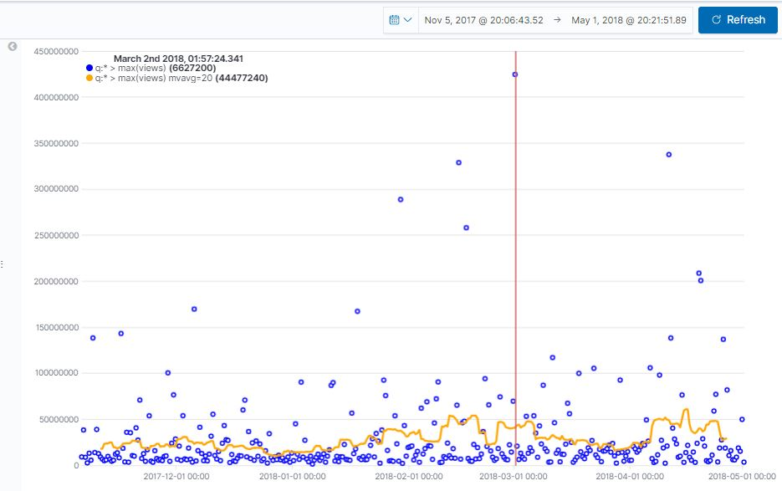
TREND OF VIEWS IN A TIME FRAME

Slide 7
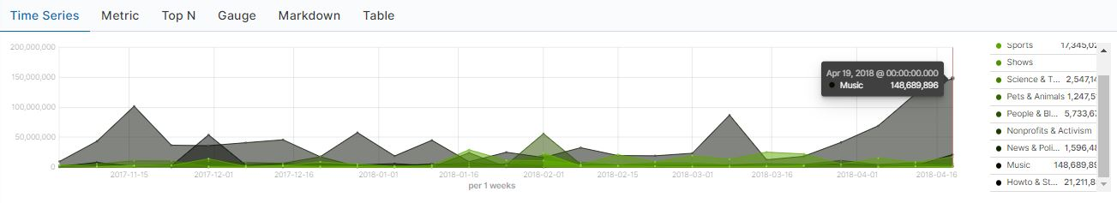
HIGHEST VIEWS FOR SPECIFIC TIME FRAME – PER WEEK

Slide 8
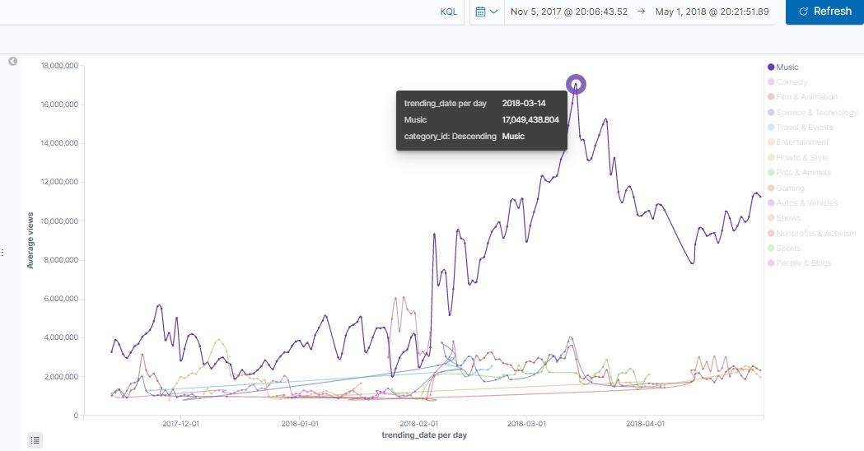
TRENDING CATEGORIES – PER DAY

Slide 9
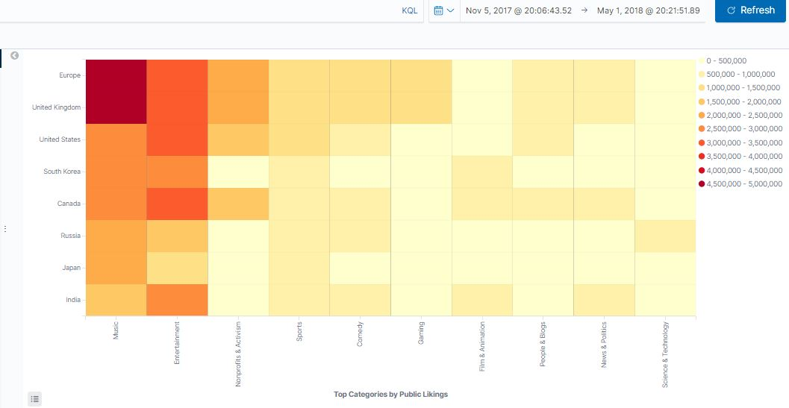
COUNTRY-WISE CATEGORY LIKING

Slide 10
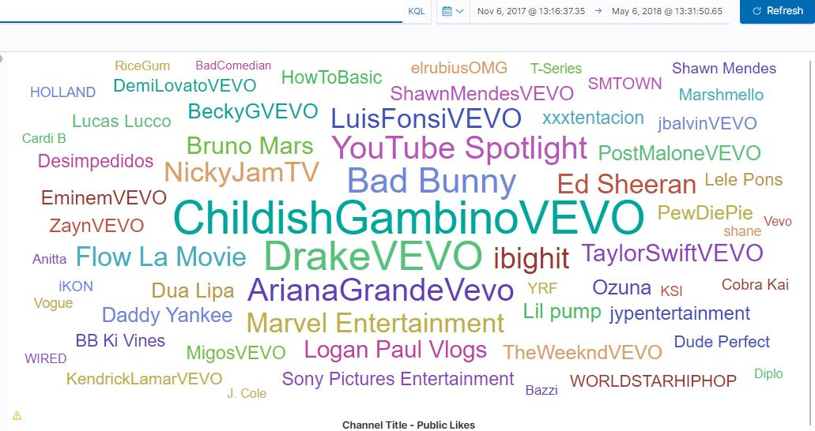
FAVOURITE YOUTUBE CHANNELS

Slide 11
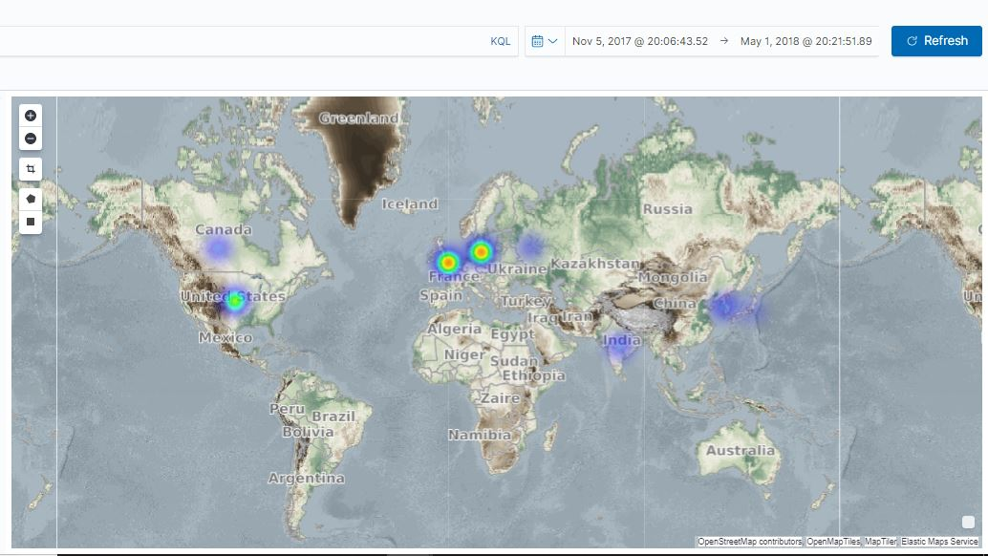
HIGHEST COMMENT COUNT PER COUNTRY

Slide 12
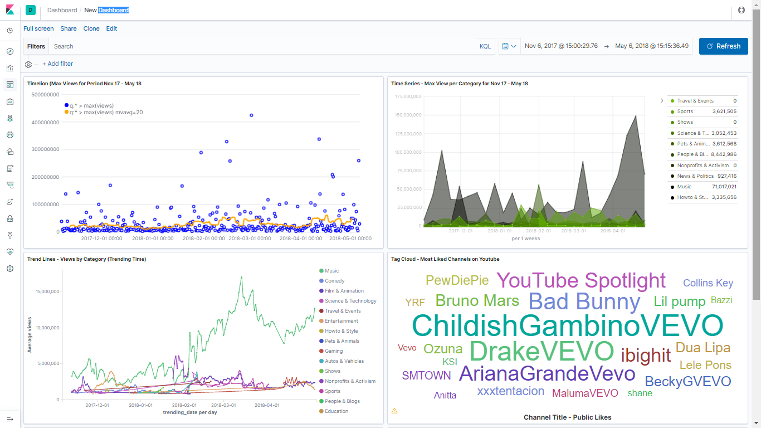
DASHBOARD

Slide 13
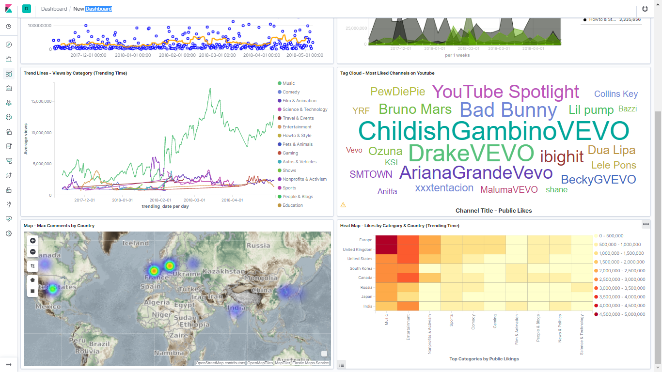

Slide 14
https://github.com/tanvigawade/ElasticSearch-Kibana.git
GITHUB LINK

Slide 15
REFERENCES
https://www.elastic.co/webinars/elastic-maps-for-geospatial-analysis?baymax=rtp&storm=ribbon-3&elektra=products-maps&iesrc=ctr
https://www.elastic.co/guide/en/elasticsearch/reference/master/keyword.html

